Slide 1
2D Transformations
y
y
x
x
y
x

Slide 2
2D Transformation
Given a 2D object, transformation is to change the object’s
  Position (translation)
  Size (scaling)
  Orientation (rotation)
  Shapes (shear)
Apply a sequence of matrix multiplication to the object vertices

Slide 3
Point representation
We can use a column vector (a 2x1 matrix) to represent a 2D point x
y
A general form of linear transformation can be written as:
x’ = ax + by + c
OR
y’ = dx + ey + f
X’ a b c x
Y’ = d e f * y
1 0 0 1 1

Slide 4
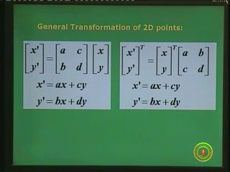

Slide 5
Translation
Re-position a point along a straight line
Given a point (x,y), and the translation distance (tx,ty)
The new point: (x’, y’)
x’ = x + tx
y’ = y + ty
(x’,y’)
ty
(x,y)
tx
OR P’ = P + T where P’ = x’ p = x T = tx
y’ y ty

Slide 6
3x3 2D Translation Matrix
x’ = x + tx
y’ y ty
Use 3 x 1 vector
x’ 1 0 tx x
y’ = 0 1 ty * y
1 0 0 1 1
Note that now it becomes a matrix-vector multiplication

Slide 7
Translation
How to translate an object with multiple vertices?
Rigid body transformation.
Translate individual
vertices

Slide 8
2D Rotation
Default rotation center: Origin (0,0)
> 0 : Rotate counter clockwise
θ
< 0 : Rotate clockwise
θ

Slide 9
Rotation
(x,y) -> Rotate about the origin by θ
(x’,y’)
(x’, y’)
θ
(x,y)
r
φ
How to compute (x’, y’) ?
x = r cos (φ) y = r sin (φ)
x’ = r cos (φ + θ) y = r sin (φ + θ)

Slide 10
Rotation
(x’,y’)
x = r cos (φ) y = r sin (φ)
x’ = r cos (φ + θ) y = r sin (φ + θ)
(x,y)
θ
r
φ
x’ = r cos (φ + θ)
= r cos(φ) cos(θ) – r sin(φ) sin(θ)
= x cos(θ) – y sin(θ)
y’ = r sin (φ + θ)
= r sin(φ) cos(θ) + r cos(φ)sin(θ)
= y cos(θ) + x sin(θ)

Slide 11
Rotation
(x’,y’)
x’ = x cos(θ) – y sin(θ)
y’ = y cos(θ) + x sin(θ)
θ
r
(x,y)
φ
Matrix form?
x’ cos(θ) -sin(θ) x
y’ sin(θ) cos(θ) y
=
3 x 3?

Slide 12
3x3 2D Rotation Matrix
x’ cos(θ) -sin(θ) x
y’ sin(θ) cos(θ) y
(x’,y’)
=
θ
r
(x,y)
φ
x’ cos(θ) -sin(θ) 0 x
y’ sin(θ) cos(θ) 0 y
1 0 0 1 1
=

Slide 13
Rotation
How to rotate an object with multiple vertices?
Rigid body transformation.
Rotate individual
Vertices
θ

Slide 14
2D Scaling
Scale: Alter the size of an object by a scaling factor
(Sx, Sy), i.e.
x’ = x . Sx
y’ = y . Sy
x’ Sx 0 x
y’ 0 Sy y
=
(4,4)
(2,2)
Sx = 2, Sy = 2
(2,2)
(1,1)

Slide 15
2D Scaling
(4,4)
(2,2)
Sx = 2, Sy = 2
(2,2)
(1,1)
Not only the object(nonrigid) size is changed, it also
moved!!
Usually this is an undesirable effect
We will discuss later (soon) how to fix it

Slide 16
3x3 2D Scaling Matrix
x’ Sx 0 x
y’ 0 Sy y
=
x’ Sx 0 0 x
y’ = 0 Sy 0 * y
1 0 0 1 1

Slide 17
Put it all together
Translation: x’ x tx
y’ y ty
Rotation: x’ cos(θ) -sin(θ) x
y’ sin(θ) cos(θ) y
Scaling: x’ Sx 0 x
y’ 0 Sy y
= +
= *
= *

Slide 18
Or, 3x3 Matrix representations
Translation:
Rotation:
Scaling:
Why use 3x3 matrices?
x’ 1 0 tx x
y’ = 0 1 ty * y
1 0 0 1 1
x’ cos(θ) -sin(θ) 0 x
y’ sin(θ) cos(θ) 0 * y
1 0 0 1 1
=
x’ Sx 0 0 x
y’ = 0 Sy 0 * y
1 0 0 1 1

Slide 19
Why use 3x3 matrices?
So that we can perform all transformations using matrix/vector multiplications
This allows us to pre-multiply all the matrices together
The point (x,y) needs to be represented as
(x,y,1) -> this is called Homogeneous
coordinates! P’ = P + T (from P’=P.M1 + M2)

Slide 20
General Fix Point Scaling

Slide 21




(a) Original position of
object and fixed point
(b) Translate object so that
fixed point (x_{F}, y_{F}) is at origin
(c) Scale object with
respect to origin
(d) Translate object so that
fixed point is returned to position (x_{F}, y_{F})^{T}

Slide 22
General Fix Point Rotation

Slide 23


(a) Original position of
object and pivot point
(b) Translation of object so that
the pivot point (x_{R}, y_{R}) is at origin
(c) Rotation about origin
(d) Translation of object so that
the pivot point is returned to
position (x_{R}, y_{R})^{T}

Slide 24
General Scaling Direction

Slide 25
y
S_{y}
x
θ
S_{x}
[R_{t}]⁻¹[S_{c}][R_{t}]

Slide 26
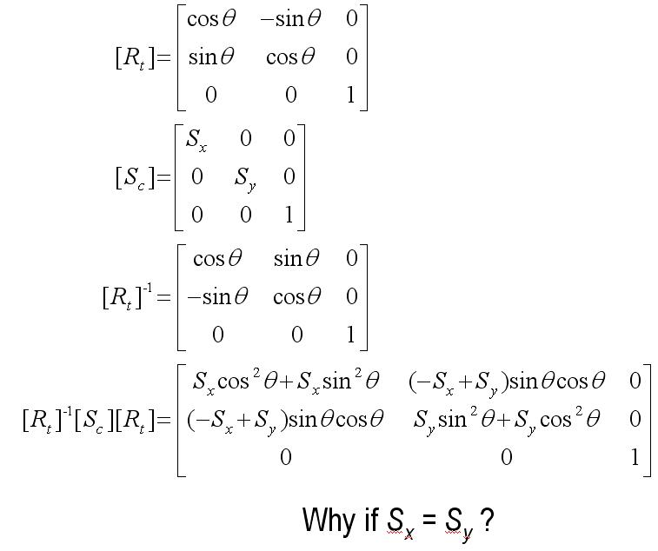
Why if S_{x} = S_{y} ?

Slide 27
y
y
(2, 2)^{T}
(1/2, 3/2)^{T}
(1, 1)^{T}
(0, 1)^{T}
(3/2, 1/2)^{T}
x
x
(0, 0)^{T}
(1, 0)^{T}
(0, 0)^{T}
45°
S_{x} = 1
S_{y} = 2

Slide 28
Concatenation Properties

Slide 29
Composing Transformation
Matrix multiplication is associative
M3 x M2 x M1 = (M3 x M2) x M1 = M3 x (M2 x M1)
Transformation products may not be commutative A x B != B x A
Some cases where A x B = B x A
A B
translation translation
scaling scaling
rotation rotation
uniform scaling rotation
(sx = sy)

Slide 30
Final
Position
Final
Position
(b) [T_{r}][R_{t}]
(a) [R_{t}][T_{r}]

Slide 31
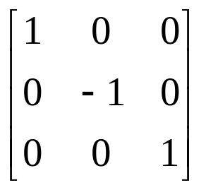
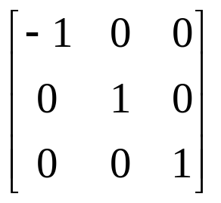
Reflection
y
y
1
Original
position
Original
position
Reflected
position
2
2’
2
3
x
3
3’
2’
3’
1
1’
Reflected
position
x
1’

Slide 32
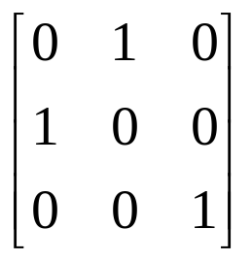
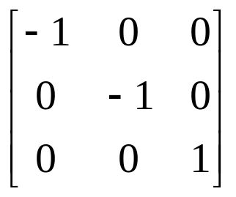
Reflected
position
y
Original
position
y
3
y = x
2’
1’
2
1
Reflected
position
3’
1’
x
Original
position
3
1
2’
3’
x
2

Slide 33
45°
45°
[R_{t}]
[R_{f}^{x}]
[R_{t}]⁻¹
Reflection about y = x

Slide 34
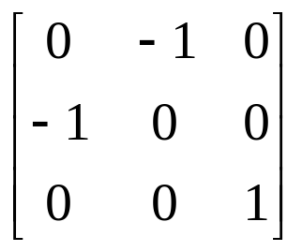
Original
position
y
y = -x
3
Reflected
position
1
2
1’
3’
2’
x

Slide 35
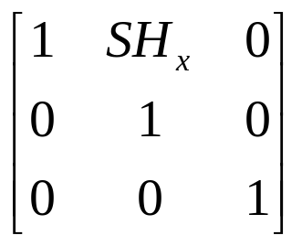
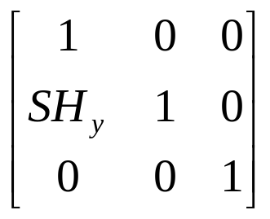
Shear
y
y
y
(1, 3)
(1, 2)
(1, 1)
(2, 1)
(3, 1)
(0, 1)
(0, 1)
x
x
x
(0, 0)
(1, 0)
(0, 0)
(1, 0)
(0, 0)
(a)
(b)
(c)

